Slide 1

Project Name:Doctor Visits Analysis
Roshan Kumar
STU66ab93f22047e1722520562
Rajkiya Engineering College Sonbhadra

Slide 2

Problem Statement
02
Understand and model doctor-visit utilization
RECORDS
TARGET
ZERO VISITS
5,190
0–9 visits
79.8%
Patient observations
Count variable
4,141 records
Key questions
• Which characteristics are associated with higher visit frequency?
• How do illness, chronic conditions, age, gender, income and insurance relate to utilization?
• Which statistical and machine-learning methods fit the target?
The target is dominated by zeros, so count-based and binary classification models are used.

Slide 3
Data & Preprocessing
03
Main transformations used in the analysis
Dataset
Derived features
• 5,190 records and 12 original variables.
• No missing values reported.
• Age converted to age_years.
• Yes/no variables encoded as 0/1.
• Age groups: 19–29 to 60–72.
• Income tiers: Low, Mid, High.
• visited = 1 when visits > 0.
DUPLICATE CHECK
Review before final modelling
3,152
The script reports duplicates but does not remove them before modelling.
Reported by the supplied script
P2 • Healthcare Analytics for Doctor Visits

Slide 4
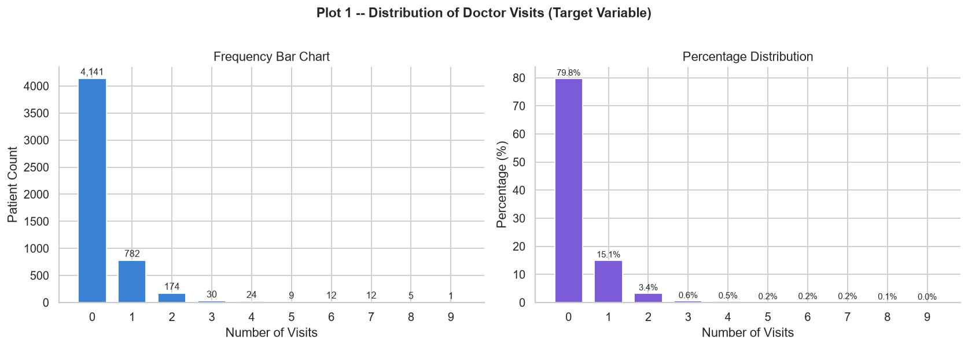
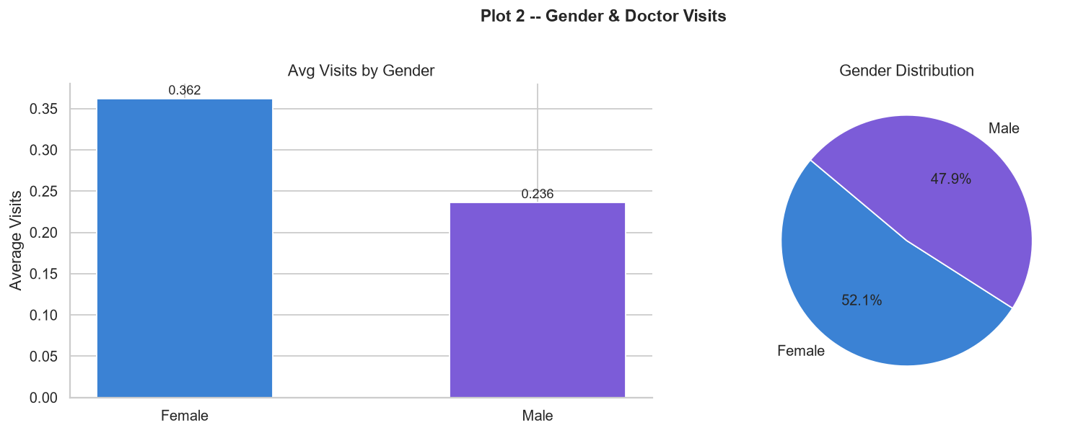
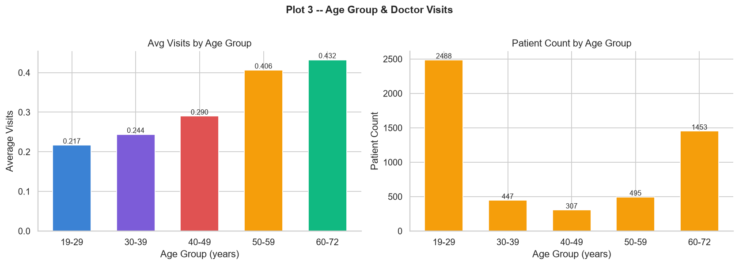
EDA — Target & Demographics
04
What the first three plots show
79.8% of patients have zero visits.
Average visits: 0.217 (19–29) → 0.432 (60–72).

Slide 5
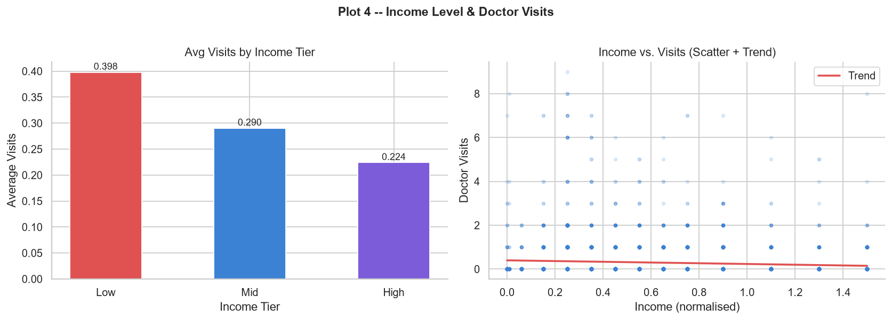
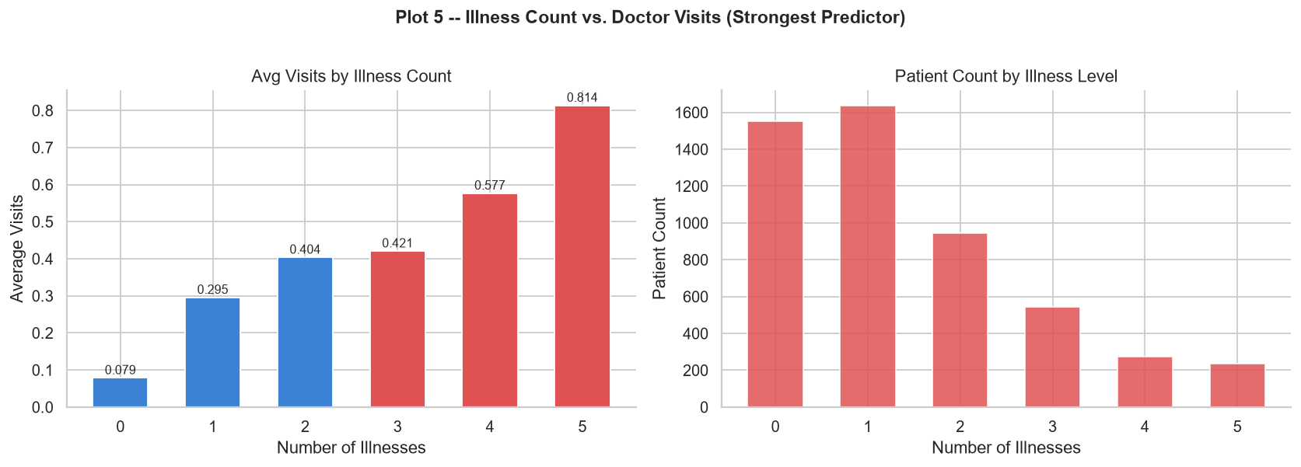
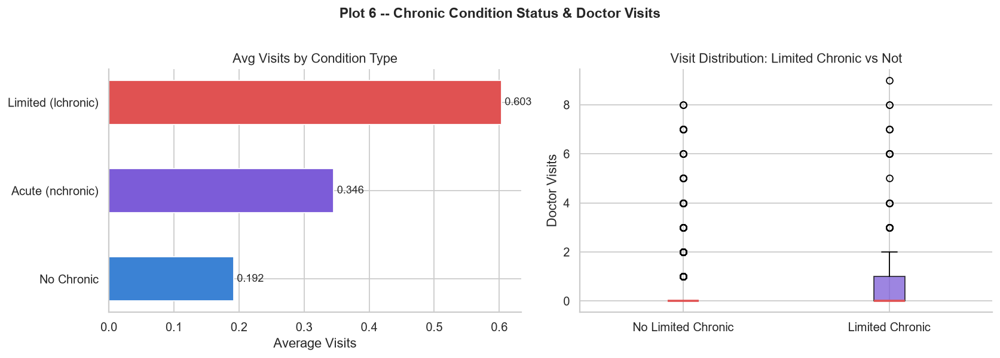

EDA — Main Utilization Patterns
05
Income, illness and chronic-condition status
INCOME
ILLNESS
LIMITED CHRONIC
0.398 → 0.224
0.079 → 0.814
0.603
Low → High
0 → 5 illnesses
Average visits

Slide 6
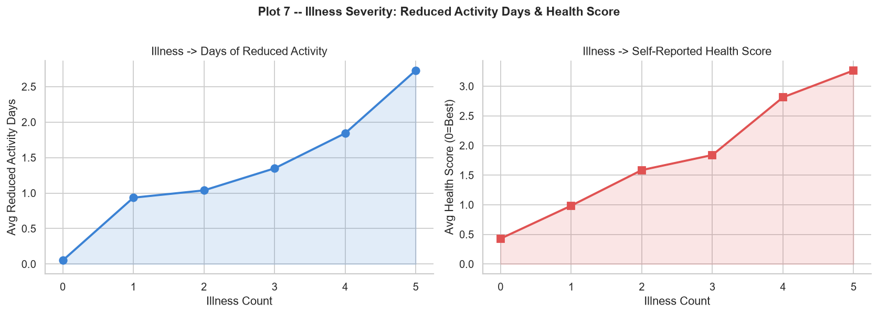
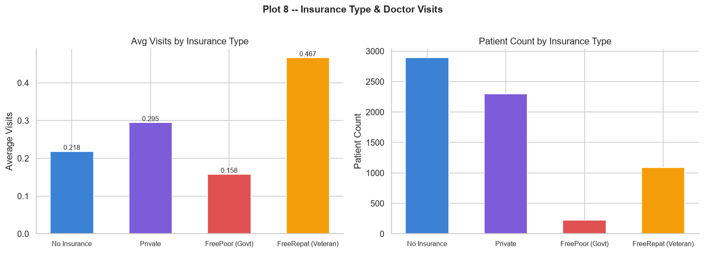
EDA — Severity & Insurance
06
Additional utilization indicators
Severity
Reduced activity and health score rise with illness count.
Insurance
Average visits vary across the four insurance categories shown.

Slide 7
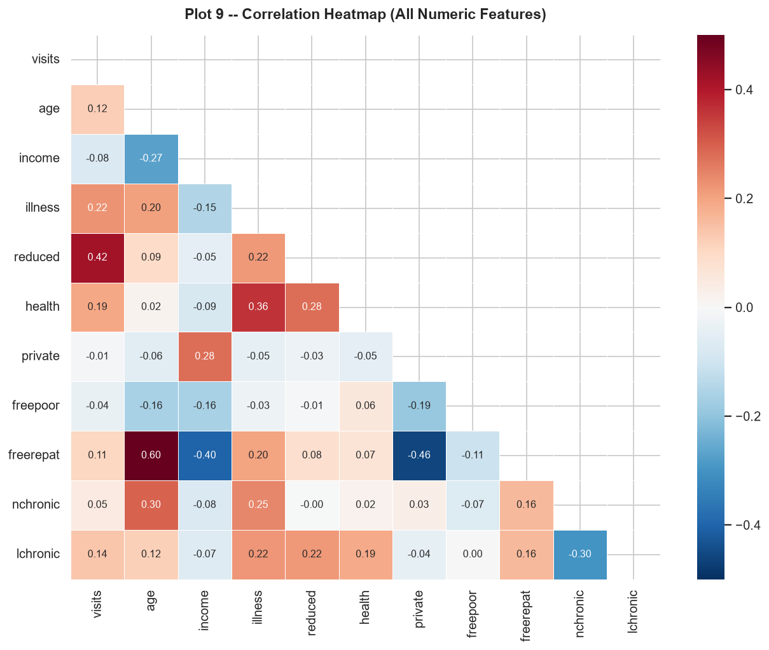
Correlation & Statistical Testing
07
Quantifying selected relationships
Correlation with visits
Reduced activity
0.42
Illness
0.22
Health
0.19
Age
0.12
Income
−0.08
Formal tests: Gender p < 0.001 • Illness groups p < 0.001

Slide 8
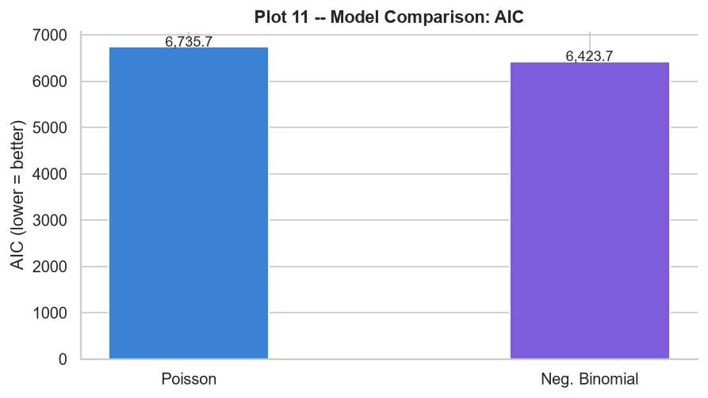
Count Regression
08
Poisson vs Negative Binomial
POISSON
AIC 6,735.7
Baseline
NEGATIVE BINOMIAL
AIC 6,423.7
Lower AIC in comparison
The outcome is a count with a large mass at zero. The script also attempts a Zero-Inflated Poisson model.

Slide 9
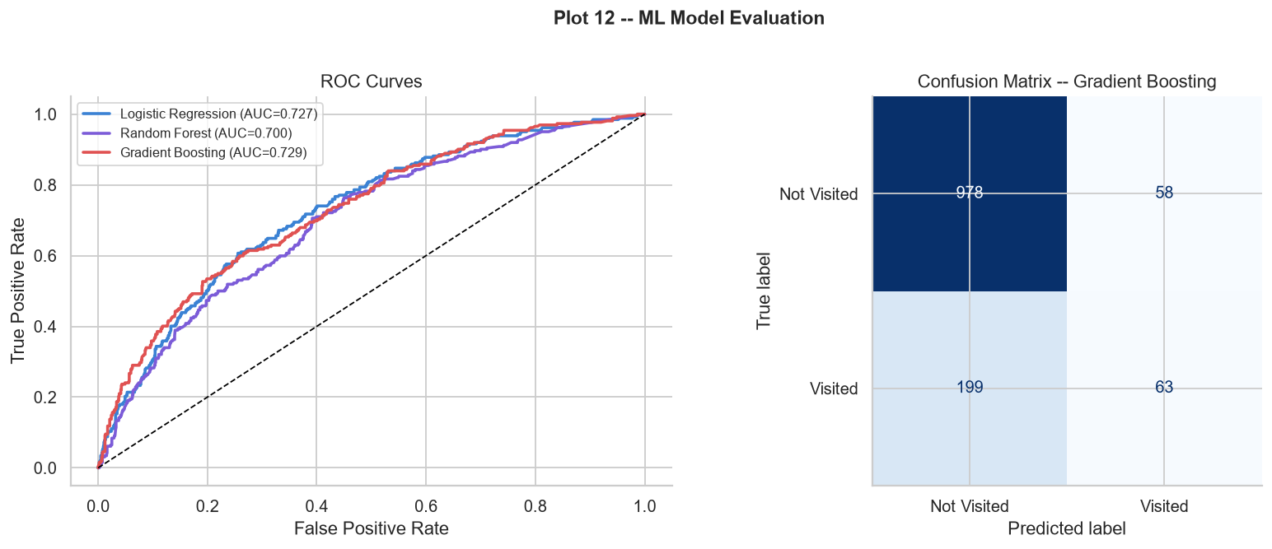
Machine Learning
09
Visited vs Not Visited
LOGISTIC
0.727
Test AUC
RANDOM FOREST
0.700
Test AUC
GRADIENT BOOSTING
0.729
Test AUC
Confusion matrix
TN 978 • FP 58 • FN 199 • TP 63
Visited recall ≈ 24.0%

Slide 10
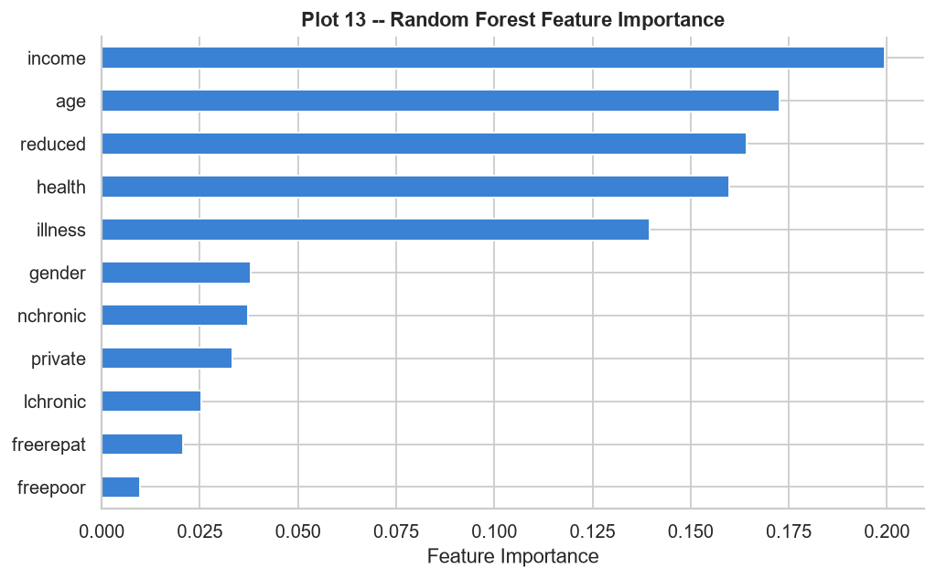
Feature Importance
10
Random Forest
Top features
Income
0.200
Age
0.173
Reduced
0.164
Health
0.160
Illness
0.140
Importance is model-specific and is not a causal effect.

Slide 11
Key Findings
11
Short summary for presentation
• 79.8% of records have zero visits.
• Average visits increase with age and illness count.
• Illness count shows the clearest dose-response pattern.
• Limited chronic-condition status is associated with higher utilization.
• Income has a small negative association with visits.
• Negative Binomial has lower AIC than Poisson in the displayed comparison.
• Classification AUC values are around 0.70–0.73.
Overall: the analysis reveals clear utilization patterns, while predictive performance is moderate.

Slide 12
Limitations & Next Steps
12
What to improve before operational use
Limitations
Next steps
• Review 3,152 reported duplicate rows.
• Observational associations are not causal effects.
• The visited class is imbalanced.
• Models need validation on separate representative data.
• Compare ZIP/ZINB explicitly.
• Use precision, recall, PR-AUC and calibration.
• Tune models with repeated cross-validation.
• Re-run after data-quality review.
WORKFLOW
Validate → Tune → Test
Then consider operational use
Demo File Github

Slide 13
13
Thank You
Questions & Discussion
Prepared by Roshan Kumar

